Slide 1

Data Analysis Task
Analysis and Insights
Raj Pravin Rajendran
07/04/2025

Slide 2



ABOUT ME
Senior Data Insight Consultant at VML
Portfolio
Raj Pravin Rajendran
Git Hub

Slide 3
Dataset:
This dataset captures customer order-level transaction data from an e-commerce platform. Each row represents a single item-level purchase within an order and includes both customer behaviour and sales performance metrics.
This dataset is well-suited for analysing customer purchase behaviour, channel effectiveness, regional sales performance, brand/category trends, and discount impact — all at a detailed, itemized order level.
From the dataset I found that between April 10 and 13, 2022, the business saw strong sales activity across all channels, regions, and product categories.
Around 44,000 orders were placed in just four days, likely boosted by promotions or seasonal demand.
In total, the company made £1.25 million in revenue from over 90k units sold, giving an average of about £13.88 per item—showing a good mix of both lower- and higher-priced products.
During this period, customers received around £163k in discounts, which is about 11.6% off the total value of all items at full price (£1.41 million).

Slide 4
Brand 5598 - Top performer. Highest revenue - over £447K, Sold the most units - more than 61k. orders overall which is near 27K. RPU is only £7.23, which suggests a low-margin, high-volume strategy.
Metrics and Insights by Brands
Brands 8178 and 7206 - Solid revenue £320K and £271K respectively Relied heavily on discounts with £51K and £85K. RPU is £ 35.93 and £26.78 which means the brands sell a little bit of an expensive product than the brand 5598.
Brand 2699 – Interesting insights Generated £162K in revenue 8,000 units sold Almost no discounting. RPU is £20.04 indicating its not a lower price and not expensive too.
Brand 6380 – Struggling
lowest revenue a £44K
fewest orders 1,050 Discounts — £22.5K. With an RPU of £42.24, the brand indicating it's a high-priced product bought by fewer customers.

Slide 5
Metrics by Region
APAC - Emerging market with pricing power Revenue £106.62K but extremely Low discounting with just £2.07K. RPU - £8.20
Europe - Margin-efficient market Revenue with £364.77K Lower discounts than the UK. RPU - £10.89
UK - strongest and most active market
£728.47K revenue
High discount value £93.14K high orders 23,411
RPU - £17.93
Asia - Lowest revenue and order volume High Discount with £15.94K. RPU - £15.59

Slide 6
Skincare Dominant Performance: Revenue - £649.17K Large Units Ordered (62,907) High Order volume (29,238).
Despite the lower revenue per unit (£10.32), the volume of orders and units ordered makes it the highest-grossing category.
Metrics by Customer Category
Cosmetics and Haircare - Strong Performers:
Significant revenue £298.14K, £276.36K Good orders (15,905). RPU(£18.75) and (£25.56) is higher than Skincare However, its order volume and units ordered are much lower than Skincare.
Other and Fragrance - High-Value Category
Highest RPU (£62.20) and (£49.91), indicating that it may be a premium-priced category. Total revenue (£9.89K) and (£7.44K) Total orders (159) and (149) are very low compared to Skincare and Cosmetics, suggesting limited customer base or market penetration.
Body Care - Underperforming:
Low revenue(£4.43K), suggesting limited interest in this category or poor market presence.
Other category has moderate performance, though its revenue per unit (£25.56) is decent, it could benefit from more visibility or strategic marketing efforts.

Slide 7




Channels Performance for all Categories
Affiliate marketing is the top driver of order volumes across most regions, categories, and brands.
Strategic HR Department
Organic reach is particularly effective in the UK, Europe, and for brand 5598 in the Skincare category.
PPC channels drives the most almost all the categories and regions.
Email marketing continues to be a key contributor for all the categories.
Marketing strategy for category other, Fragrance and Body care is not working well in terms of orders

Slide 8
Revenue, Units and RPU by Category and Brands
Both the visuals show the relation between units sold and revenue at category level. We can understand that Skincare has the highest market share in both the units sold and revenue across all regions. Although the category skin care has low RPU products, due to the volume of units sold it generates a higher revenue.

Slide 9
Total Revenue and Discount by Region and Brands
This visual shows an brand level daily data for Revenue and Total discount. Additionally it shows the performance of the metric compared to previous day.
The discount section has a anomaly for UK with the discount decreasing to 488 Million times, it is due to the previous week discount being somewhere in the range of pound 49 and the current week discount being 0.0001 pounds.

Slide 10
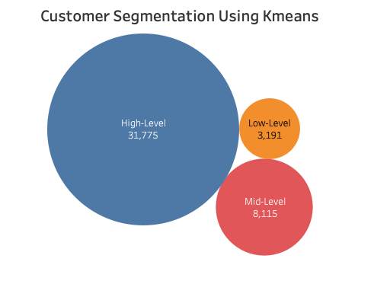




Segmentation of Customers – Kmeans and Insights
Total Customers – 3191 Customers buying only from brand 7206 Discount is too high
Total Customers – 8115 Buying from brands 7206 and 8178 Discount is relatively high
Total Customers – 31,775 Buying from brands 5598 and 2699 Almost none of the customers used discount and bought

Slide 11
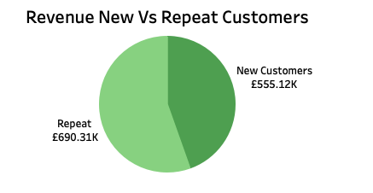
Segmentation of New Vs Repeated Customers:
Repeat customers generated £690.31K, which is around 55% of total revenue.
New customers generated £555.12K (~45%).
Affiliate and PPC is working the best for both New and repeat customers. Also, the brand 7206 and 8178 have less percentage of orders via PPC but still collected good amount of revenue. The channel other is not making revenue for any of the brands which need to be checked ROI of the campaigns sent and may be we can remove it in the future.

Slide 12
Metrics and Insights by Day And Hour
Both New Customers and Old Customers have their highest order activity in the afternoon (hours 12-21).
New Customers show more consistent orders throughout the day, especially in this time frame, indicating that we're acquiring more new customers during these hours.
On the other hand, Old Customers also have solid activity during the day, but not as strong or consistent as New Customers.
Strong Mid-Period Peak:
There's a noticeable peak on April 11 and 12, showing a 10% increase from the previous day for the New Customers.
This could be influenced by weekend activity, since April 12 is Sunday. Hence, we can consider that weekend we are attracting New customers through our campaigns.

